Slide 1
General Resource Theories in Quantum Mechanics

Slide 2


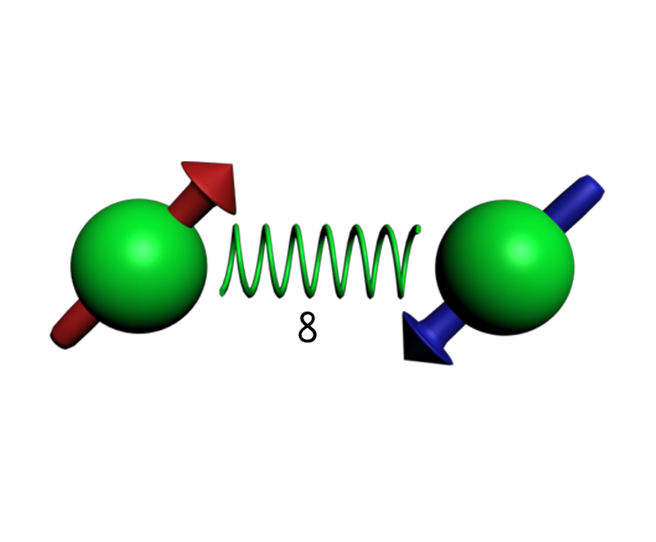

Quantum Mechanics
Dead and Alive?
Spooky action at a distance
Uncertainity

Slide 3
Quantum Applications
Quantum Data
Quantum Cryptography
{0,1}
α “0” + β “1”
Quantum Computing
Quantum Communication

Slide 4

Quantum Advantage
What makes quantum better?
Algorithms / Computation :
Cryptography:
Teleportation (communication):

Slide 5


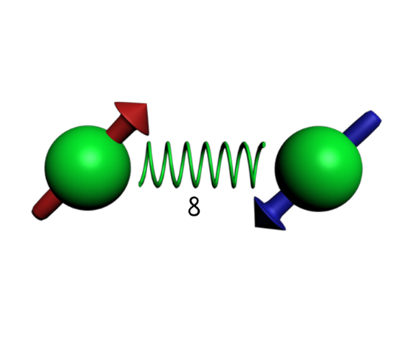
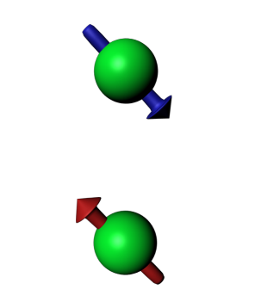
Resource theories
Restriction
Resource
Local Operations

Slide 6
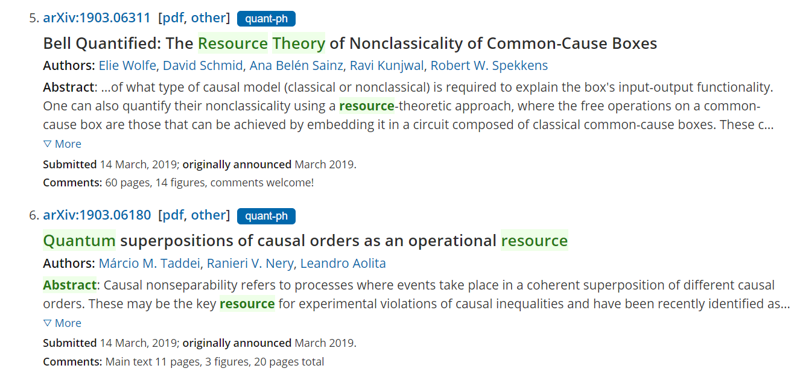
Known resource theories
Assymetry
Non-locality
Non-Guassianity
Non-markovianity
Quantum correlations
Entanglement
Coherence
Thermodynamics
Purity

Slide 7
General resource theories
All States
Free States
Free States
Free Operations
Free States
{ Free states, Free operations} = Resource theory

Slide 8
Questions we can ask
Resource characterization
I can do x task with y process
only if I have z resource
Resource quantification
I have x state so I have
y amount of resource
Resource distillation/manipulation
Given many states with little
Resource, create few states
With high resource

Slide 9
Thank You

